Slide 1
Gender Dimension of Disinformers’ Confrontational Style: Use of gendered ad hominem attacks in Czech disinformation websites
Iva Svačinová & Petra Vodová

Slide 2
Outline
Outline
Czech disinformation scene
Ad hominem (AH) attacks
Gendered dimension of AH
Second- and third-person AH
GAH as part of disinformersʼ confrontation style
Primary and secondary audiences
Research questions
Methods
Results

Slide 3
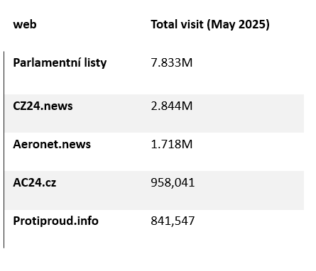
Czech disinformation scene
“Disinformation websites”, “conspiracy websites”, “anti-system websites”
(1) opaque ownership structure, (2) anonymous authors and editorial teams, (3) lack of proper source citations/provision of irrelevant or dubious sources, and (4) known history of spreading disinformation and pro-Kremlin propaganda (Cvrček, Fidler 2024)
A clear illiberal, nationalistic, and socially conservative orientation (Štětka et al. 2021, Macková et al. 2025, Syrovátka 2021)
Approximately 40 such websites currently operating in the Czech Republic

Slide 4
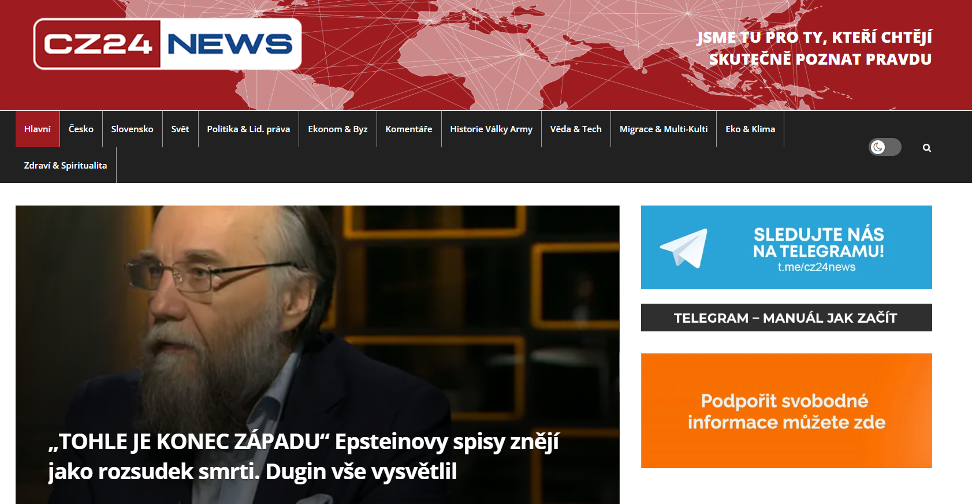

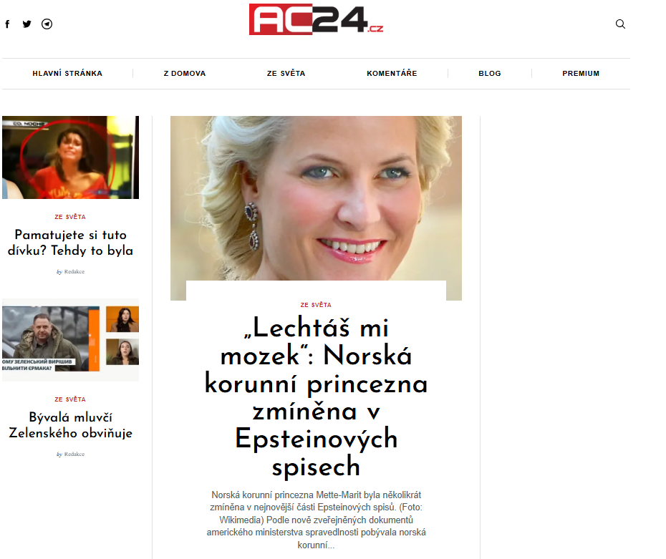
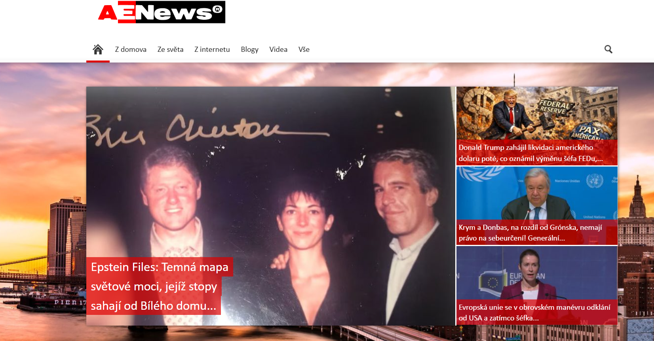
Czech disinformation websites
Obrázky

Slide 5


Czech disinformation scene
An ideological alternative to mainstream media (Rauch 2010, Holt et al. 2019)
Content that is politically, socially, culturally radical, anti-hegemonic, or alternative in its epistemological foundations
Susceptibility to conspiracy myths
Disinformation, populist narratives, narratives based on conspiracy theories
2015:
Disseminating anti-immigration, Islamophobic, and anti-EU content
“Deep State Theory” alleging the existence of a covert government within a government, the “Theory of New World Order”
Disinformations tailored to the Czech Republic (Štětka et al. 2021, Cvrček, Fidler)
2022:
Fermenting distrust towards the Czech government (composed of democratic center-right parties since 2021)
Especially in relation to its support of Ukraine (Nemečkayová, Havlíček 2024)
Official story
Alternative story
MM
AM

Slide 6
Ad hominem (AH) attacks
Pragma-dialectical view (van Eemeren, Grootendorst 1992)
Goal of discussion: to resolve difference of opinion (+ win the discussion)
4 stages of critical dialogue
(1) confrontation stage
(2) opening stage
(3) argumentative stage
(4) concluding stage
10 rules
(1) Freedom rule: Discussants may not prevent each other from advancing standpoints or from calling standpoints into question.
(2)….
(3)…
Abusive AH:
= Attack aimed at the person’s character rather than their ideas
“by portraying the opponent as stupid, dishonest, unreliable or by stating otherwise negative aspects, an attempt is made to undermine their credibility” (van Eemeren and Grootendorst 2015: 616).
AH silences the opponent, thus preventing them from presenting a standpoint, argument, or raising criticism, and thereby disqualifies them as a serious partner in the discussion (van Eemeren, Grootendorst 1992)

Slide 7
Gendered dimension of AH
Ad feminam (Herbeck and Mehltretter Drury 2024)
“an attack against a specific woman grounded in her character rather than the argument or position she espouses”
Ad masculum
An attack against a specific man using his resemblance to women
Strategies of feminization, emasculation
Appearance: ugly
Competence: not qualified/competent, lacking the requisite knowledge/intelligence (“dumb blonde”)
Character, integrity: too emotional for the task, untrustworthy, prone to aggression, lacking sanity, unhonest
Sexuality: is/is not sexy, comitting unappropriate sexualized behavior/illicit affairs, too or not moral enough (“virgin”/“whore”)
Appearance: feminine physicality
Strength: weak
Leadership role: “beta,” subservient to women, inferior or weakened by women
Sexuality: sexual submissive or deviant from heteronormativity (e.g. homosexual)

Slide 8
Second- and third-person AH
Second-person AH
Third-person AH
causing self-doubt, intimidation, fear or rage
creating a negative ethos
policing one’s own allies
cooling effect on dialectical communities (Aikin 2025, Zuloaga 2024)
You are an asshole!
is an asshole!

Slide 9
AH as part of disinformersʼ confrontation style
Argumentative style (van Eemeren 2019, 2021)
consistent, strategic shaping of discourse through the systematic selection of topics, audience appeals, and presentational techniques
Confrontation style (Peng 2021)
(1) to agree, i.e. to accept the difference exactly as defined by the opponent or
(2) redefine the difference to change the opponent’s position (doubt/opposition)
(3) exclude the difference from the need for resolution (thus stopping the argument)
Compromising
Uncompromising

Slide 10
Primary audience
Readers of disinformation websites (SYRI 2023):
(1) strong disinformation supporters
(2) moderate disinformation supporters focused on Covid-19
(3) moderate disinformation supporters focused on migration
(4) the “there might be something to it” group (a group of very moderate supporters)
Audience that is supportive or (relatively) receptive
Disinformers need to strenghten its confidence in the alternative story, so they try to weaken the acceptability of the official story (by attacking its proponents)
Third-person AH
Effect: Reinforcing or arising negative ethos of proponents of official story → thus wakening epistemic authority of representatives of official story
is an asshole!

Slide 11
Secondary audience
mainstream journalists
pro-democratic political representatives
Disinformers are in deep disagreement with their opponents
Their opponents cannot be persuaded of the acceptability of alternative story
It seems advantageous to end the dispute in such a way that the other side resigns
Second-person AH
Effect: Arising self-doubt and fear
…Cumulative and rather delayed effect
You are an asshole!

Slide 12
Expectations about disinformers’ use of GAH
AH as part of disinformersʼ style?
Matos et al. (2022): false news (disinformation, misinformation) exhibits a higher occurrence of abusive language compared to regular news
Oswald (2016): AH is one of prototypical fallacies used by conspirators
GAH?
Czech context: empirical studies (Mottlová, Šprinclová 2025, Kužel 2025, Tkáčová 2025, Vařeková 2024)
Experiences of female politicians “reveal that while all (mostly governmental) politicians face criticism, women are singled out with mockery and attacks that draw on gendered stereotypes, questioning not only what they stand for but also whether they belong in politics at all.” (Tkáčová 2025)
…No studies for men

Slide 13
Research questions
Q1: How frequent are ad hominem attacks generally in texts?
Q2: Are gendered attacks more frequent than the attacks connected to other topoi?
Q3: Are gendered attacks more frequently targetted on women than men?
Q4: What types of character features make content of attacks on men and women?

Slide 14


Protiproud
One of Czech disinformation websites
Author Petr Hájek
The former press secretary of a former Czech president Klaus
Fifth most read website in Czech Republic
Addresses hunderts thousands people a month
Hájek – one of the authors
Reprints Russian propaganda, connected to funding from Russia

Slide 15
Data collection
November 2021 – June 2025 (centre-right coalition government of Petr Fiala)
Pro-Western
Help to Ukraine and to Ukrainian refugees
2160 texts at total
Searching for names of top government-related politicians
Fiala, Rakušan, Lipavský, Jurečka, Blažek
Pekarová Adamová, Černochová, Langšádlová, Richterová, Nerudová
487 texts -> searching for attacks
portraying the opponent as stupid, dishonest, unreliable or by stating otherwise negative aspects, an attempt is made to undermine their credibility
Q1: 800 attacks (1.6 per a text)
Coding of attacks – qualitative content analysis
Buttom up analysis
Identifying common topics and including them to bigger common categories

Slide 16
Ad hominem attacks
In relation to… | Topics
State or its citizens | elitist, liar, loser, migration supporter, totalitarian, big spender, saboteur
Political office | incompetent, fanatic, criminal, mobster, rebel, opportunist, publicity seeker, power abuser
Foreign states | puppet of the West, warmonger, traitor
Own party | despised person
Character failure | arrogant, immoral, coward, careerist, lunatic, hypocrite
Gender (female) | stupidity, physical appearance, snob, aggresive, quota, imaturity, sexual attack
Gender (male) | physical appearance, drug addiction (weakness), mama's boy, immaturity

Slide 17
Types of ad hominem attack (total distribution)
Majority of attacks are „political“
Gendered attacks
minority (9.6% of ad hominem attacks) (Q2)
Probably not surprising
if so, targetted on female politicians (Q3)

Slide 18
Attacks targetted on individual politicians
Political attacks distributed to all politicians
Harm to state/citizens, political office, or towards foreign states
Gendered attacks targetted to all female politicians (15-40%) and only some male politicians (up to 12%)

Slide 19
Gendered attacks
Female politicians:
Physical apperance
Stupidity
Childlish behavior
Submisive, sexual offence, snob, quota
Only targetted to Černochová
Male politicians
Physical appearance
Drug addiction (appearance, weakness)
Mama‘s boy, childlish behavior

Slide 20
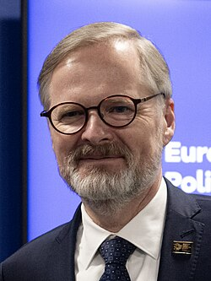
Variability in attacks: male politicians
Petr Fiala (ODS)
Prime Minister
Incompetent, totalitarian-acting, overspending and lying saboteur of state and its citizens
But! – no attack on his appearance, or masculine behavior
Truly political attacks

Slide 21
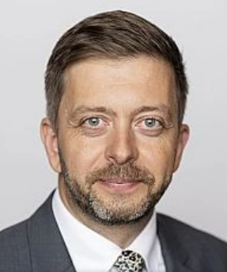
Variability in attacks: male politicians
Vít Rakušan (STAN)
Minister of Interior
Deputy Prime Minister
Dangerous, bad guy
Totalitarian-acting mobster, who supports immigration to Czechia (~migration pact, Dozimetr affair)
Very limited gendered attacks, but present
„Ropušan“ (eyes like a toad)
Drug-addicted eyes

Slide 22
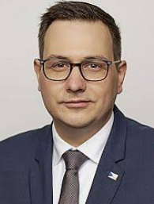
Variability in attacks: male politicians
Jan Lipavský (Pirates)
Minister of Foreign affairs
Puppet of the West and warmonger (minister of pro-Western government)
But, other consistent attacks are targetted on his young age
Incompetent
Gendered: mama‘s boy, immature, physical appearance („bizzare fatty“)

Slide 23

Variability in attacks
Markéta Pekarová Adamová (TOP 09)
Chair of the Chamber of Deputies
No ministry
Low scores in almost all categories, but:
Stupid puppet of the West
„Hen“, „extraordinarily intelligent“, „astronomic IQ“, or just „stupid“
Physical appearance: „Bazedová Pekarová“ (~Basedow disease)
„Basedow monster“, „physically monstrous“

Slide 24
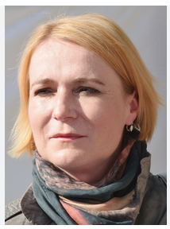
Variability in attacks
Jana Černochová (ODS)
Minister of Defence
Most attacks connected to vision of her as a warmonger lead by the West enemies
Gender – various, but nothing prevalent
Obese, „baba jaga“
Snob, Sexual excitement by tanks
Quota

Slide 25
Conclusion
Ad hominem attacks are very frequent and connected to almost every mention of the name of the politician
Gendered attacks are, however, quite rare and targetted to women
Not surprising – it is not enough to make only gendered attacks when criticizing politicians
Attacks for all politicians are firstly targetted on their portfolio and political activity/affairs irrespective to gender
Minister of interior – „totalitarian“
Minister of foreign affairs, minister of defence – „Western puppet and warmonger“
But, gendered attacks consistently addition the whole negative image of female politicians (but only in a small range for male politicians)
Physical appearance, stupidity as the most important, but others also depict the negative image of the minister – easy attacks?
Probably not functional when thinking of men in politics?
Further work – analysing more websites – consistent pattern or different approach?

Slide 26

Thank you for your attention
This work was financially supported by the project Knowledge in the Age of Distrust (CZ.02.01.01/00/23_025/0008711)

